Slide 1
BLOOD DONATION CENTER
BY
R.PHANINDRA KUMAR &
K.PRASANTH REDDY

Slide 2
BLOOD DONATION CENTER
THE WEB PAGE CONSIST OF:
HOME PAGE
DO YOU KNOW?
WHO YOU CAN HELP
DONATION TYPES
ETHNIC GROUPS
DONATION CENTER NEAR YOU & REGISTER

Slide 3
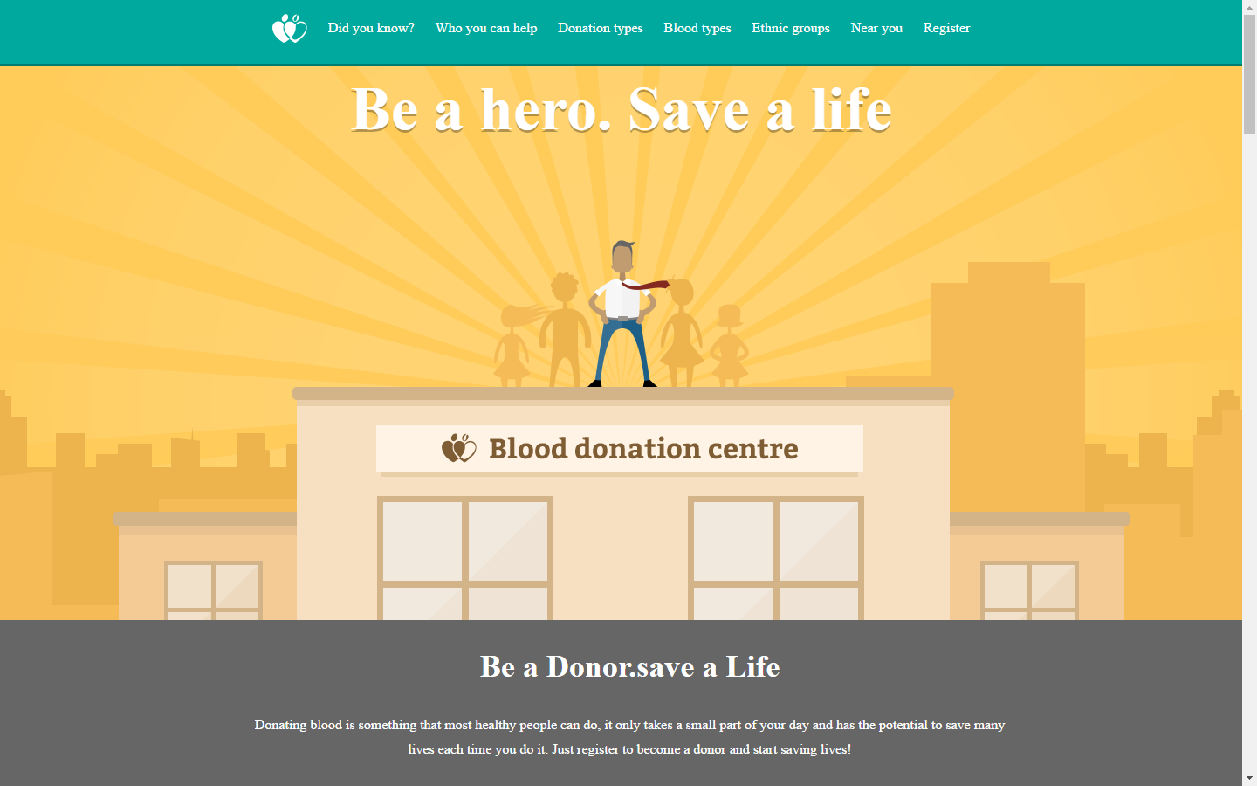
HOME PAGE

Slide 4
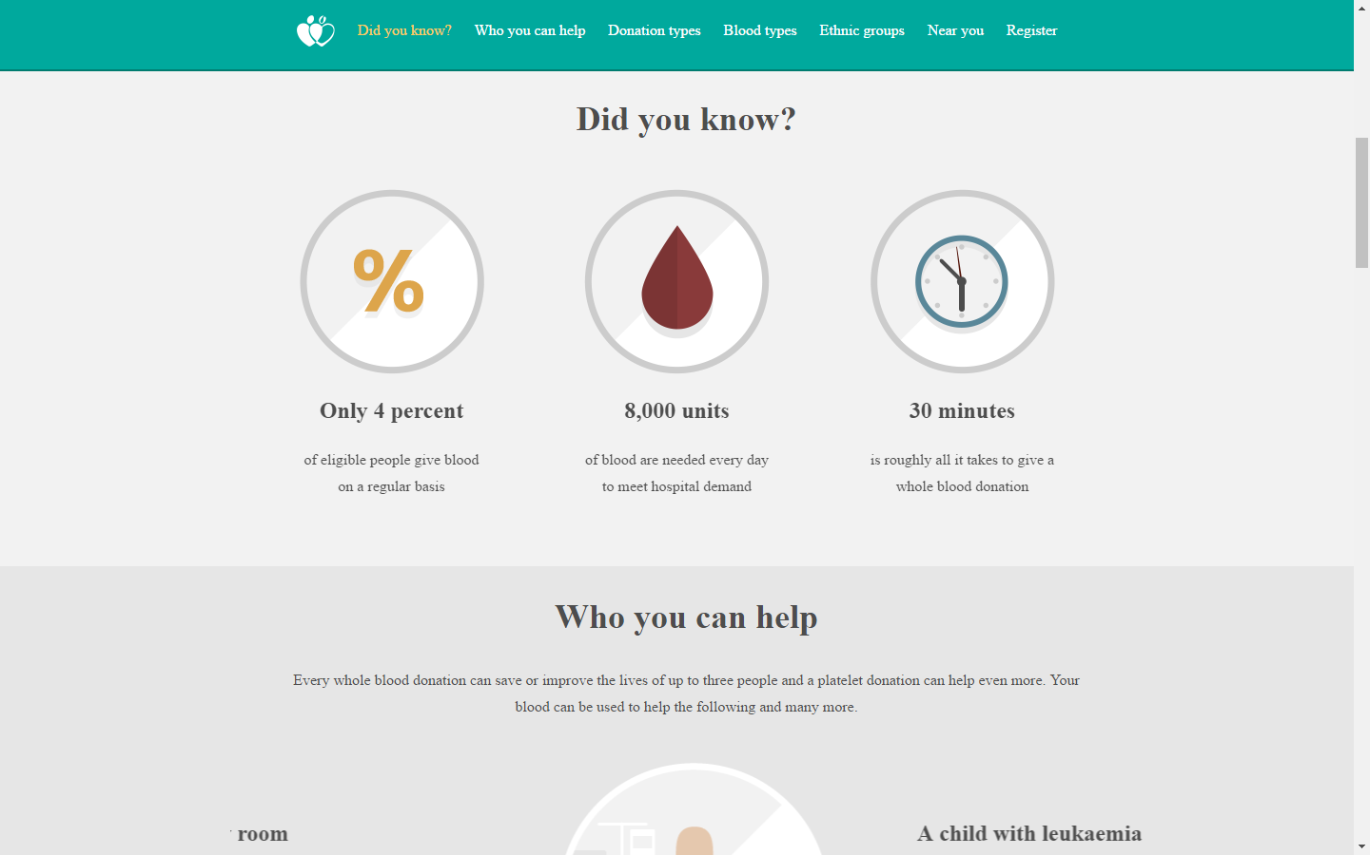
DID YOU KNOW?

Slide 5
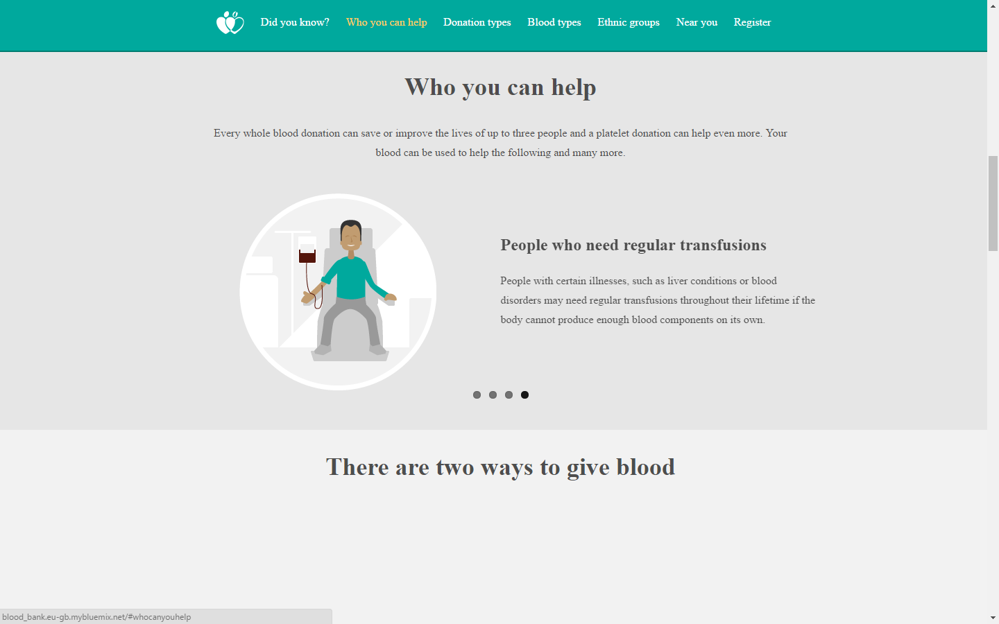
WHO CAN HELP YOU

Slide 6
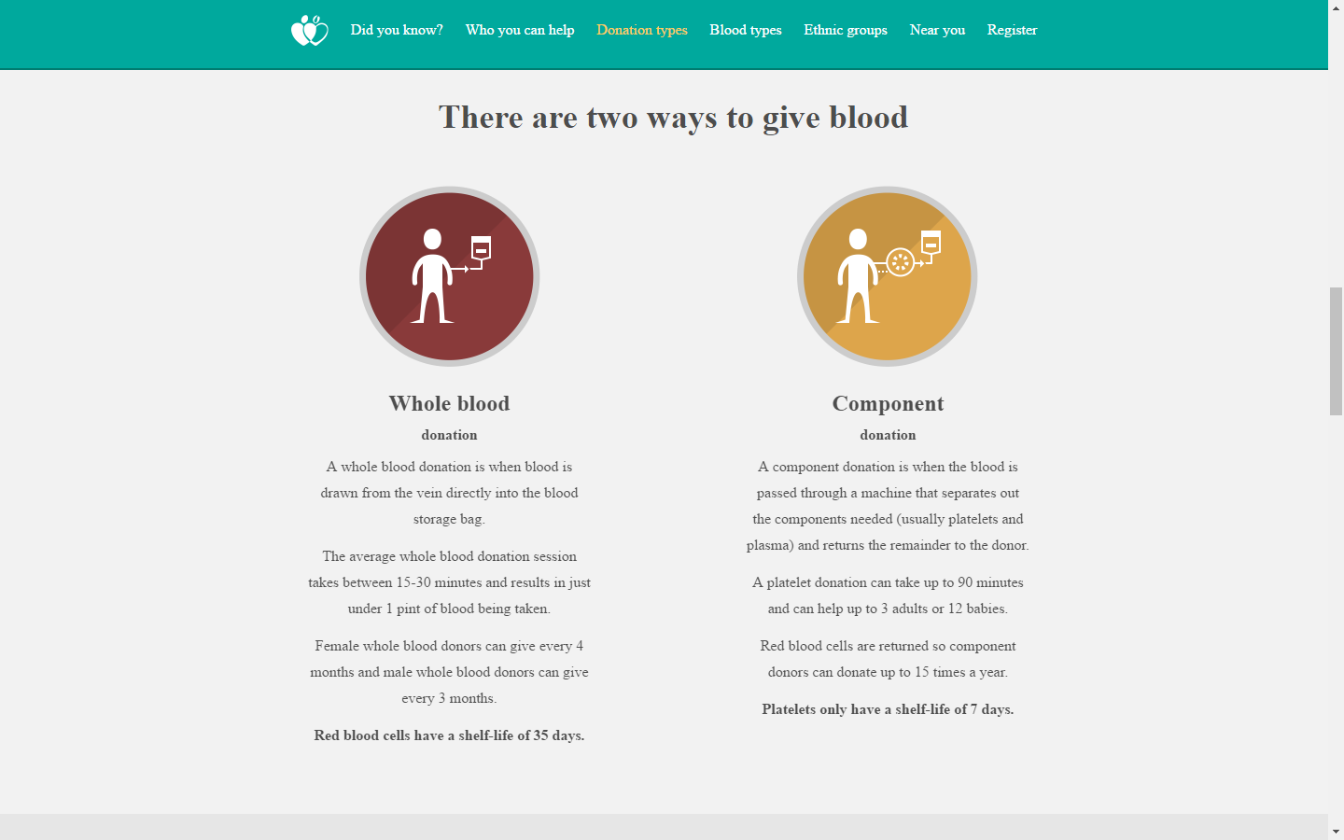
DONATION TYPES

Slide 7
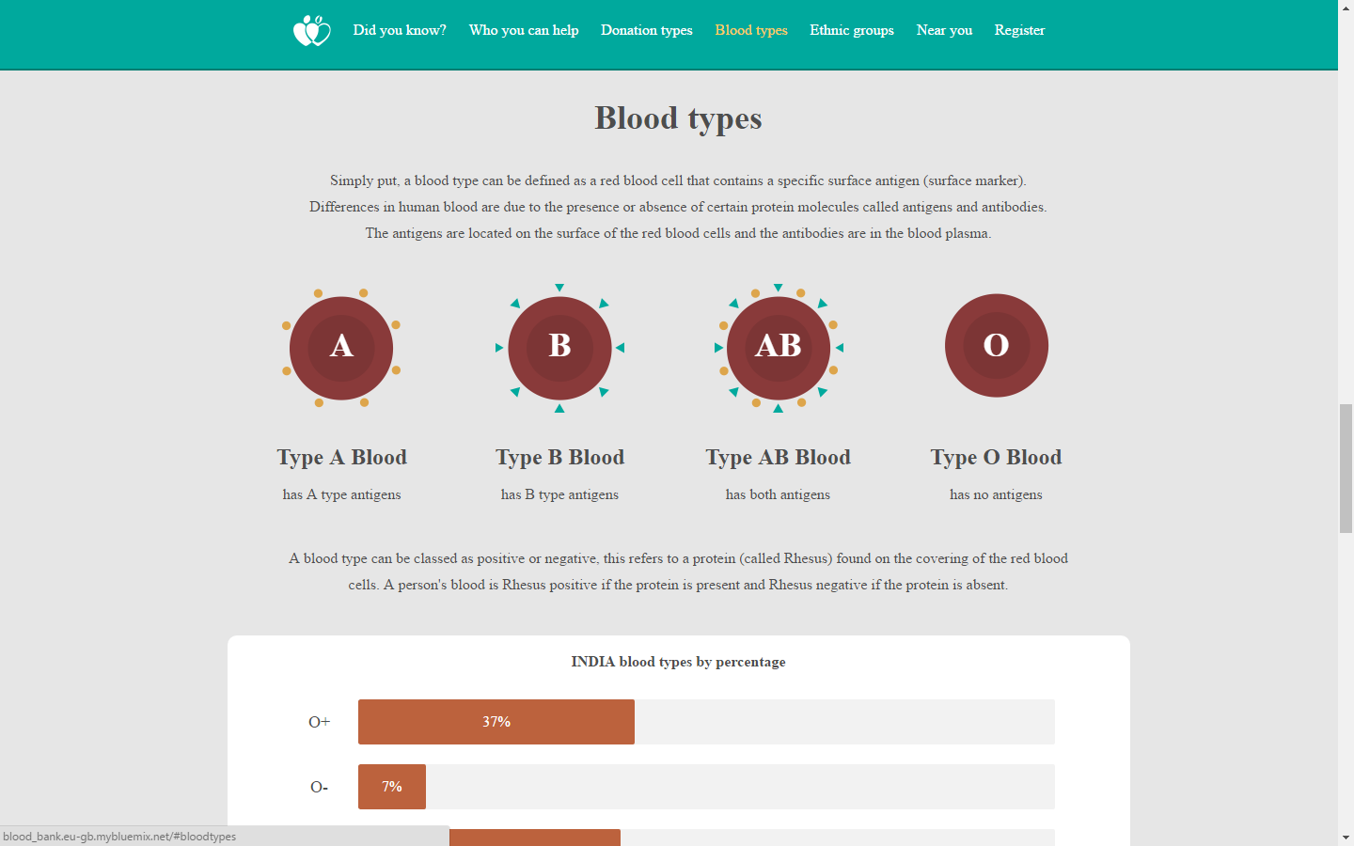
BLOOD TYPES

Slide 8
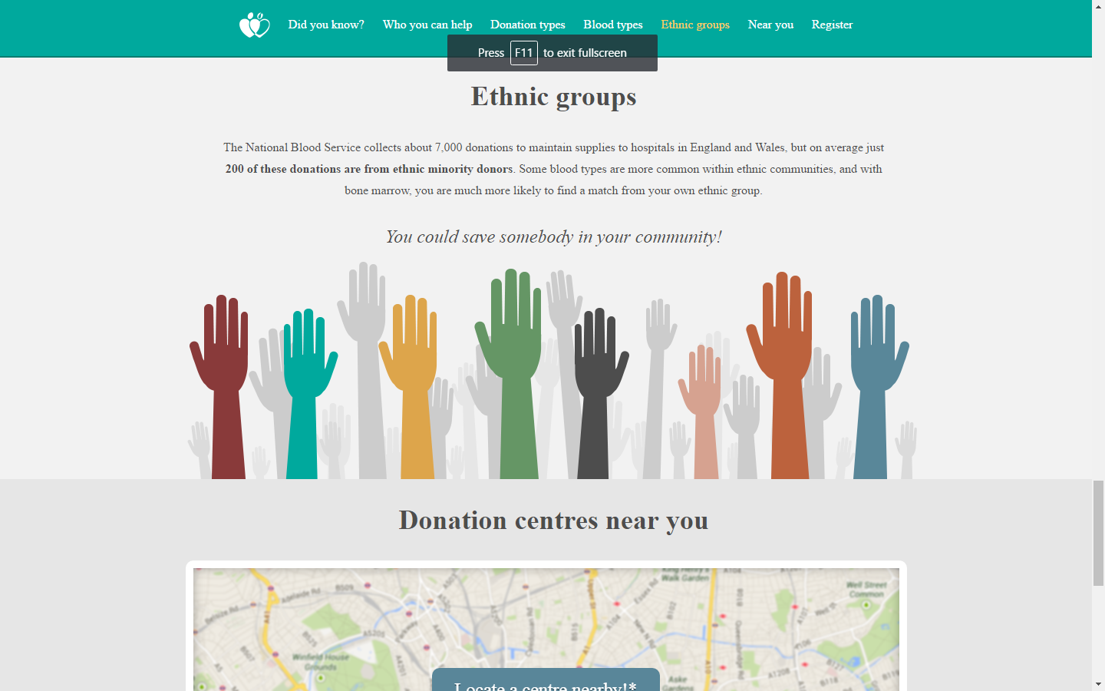
ETHNIC GROUPS

Slide 9
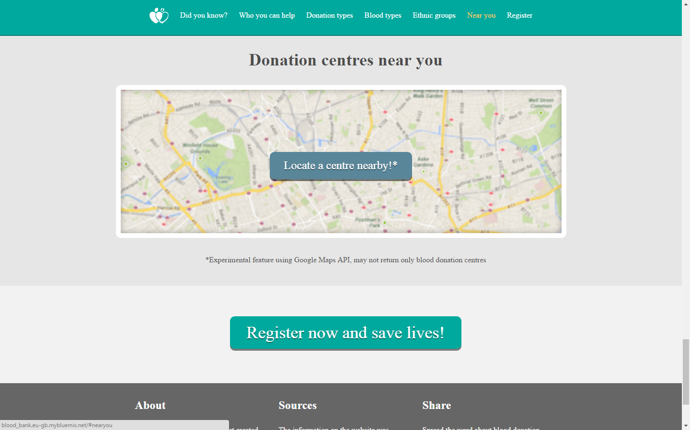
DONATION CENTER NEAR YOU&REGISTER

Slide 10
THANK YOU

